Slide 1

HDMA Washington Home Loans Prediction

Slide 2
Overview
The Home Mortgage Disclosure Act (HMDA) requires many financial institutions to maintain, report, and publicly disclose information about mortgages. The project uses this data to make loan approval predictions.
Data is at https://www.kaggle.com/miker400/washington-state-home-mortgage-hdma2016/home
This project builds prediction model to help bank make data driven decisions and features affecting loan approval.
This project is divided into three parts Data Wrangling, EDA and Prediction Model.

Slide 3
Data Wrangling
Following data cleaning methods are used
Drop Columns - Columns with few data elements are dropped
Column Data Types – Data type of Columns with categorical data is changed to “Category”
Missing Data – Columns containing less than 20% of “NaN” data are dropped. Columns with greater than 20% of “NaN” data are imputed to median values and values based on other column values.
For ex - Substitute missing values in msamd_name with value based on value in census_tract_number
Outliers - Outliers are visually inspected with box plots and filtered out.

Slide 4
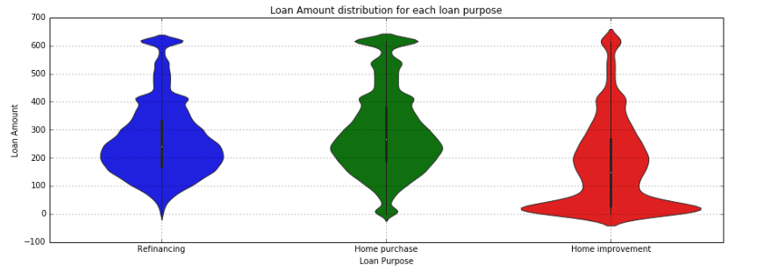
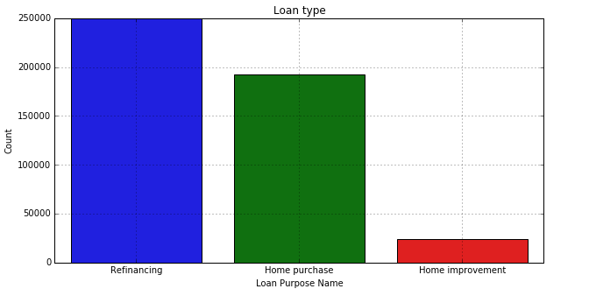
Data Story
Distribution of loan amounts are between 150K to 300K across all the Metropolitan areas, loan purpose and action taken.
Seattle-Bellevue-Everett Metropolitan area largest population and highest income and most number of applicants.
Most of the loans applications are either for Home purchase or Refinancing.
Most of the loan applicants are Male.
Most of the loan applications are conventional loans

Slide 5
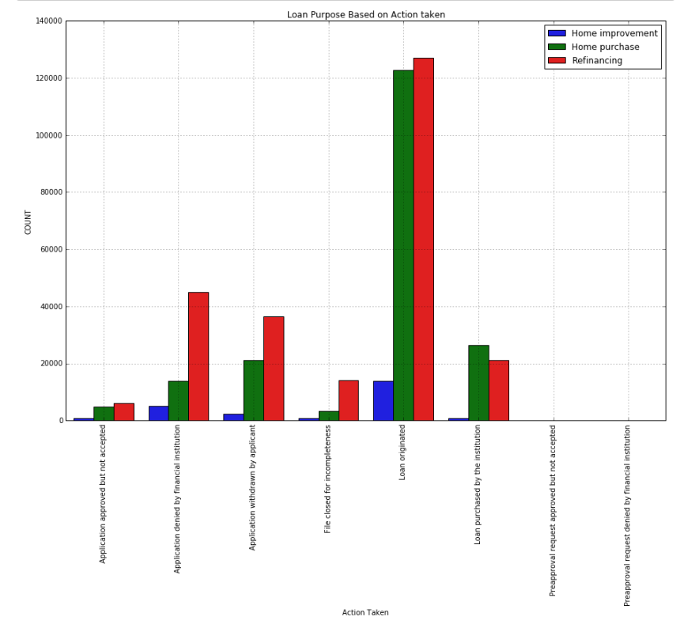
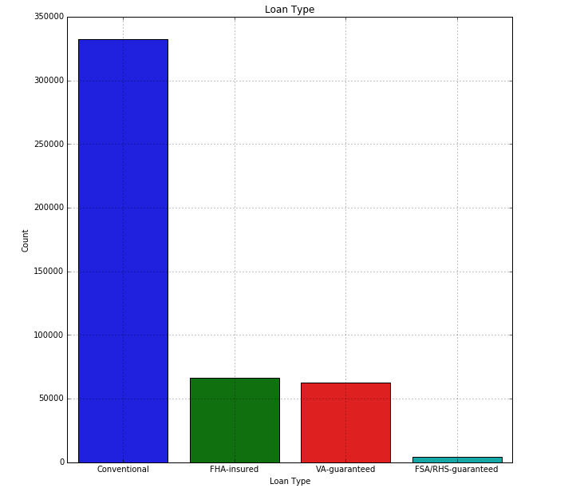
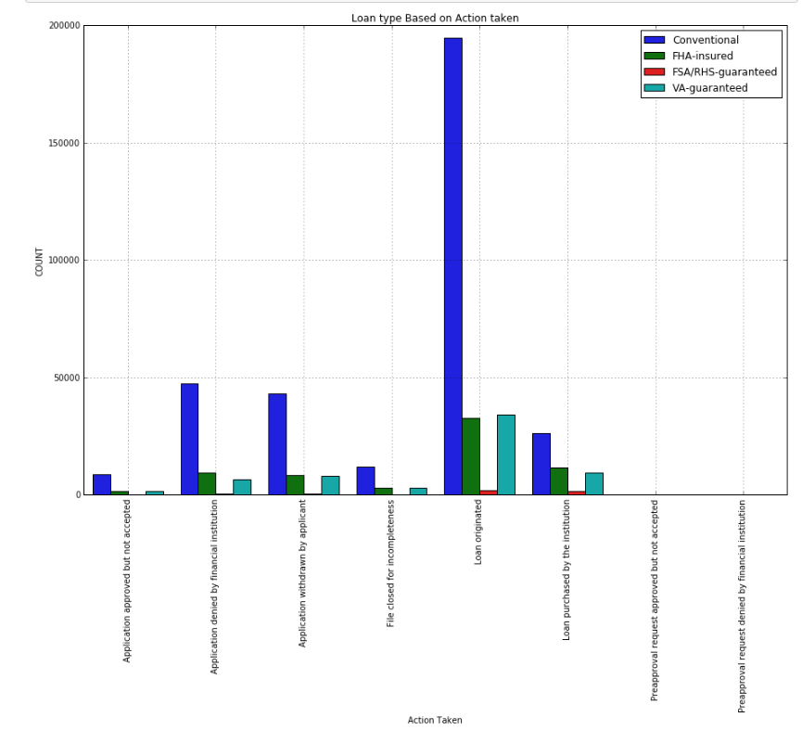
Data Story

Slide 6
Data Story
Action taken trends –
Loan applicants in each action taken category is “Not Hispanic or Latino”
Seattle-Bellevue-Everett Metropolitan area has the highest loan approval this could because of highest number of loan applications.
Most of the loans applications accepted are either for Home purchase or Refinancing
Conventional loans types are most accepted

Slide 7
EDA
Gender Bias
A hypothesis test was conducted to determine Gender bias.
A t-statistic and P-value was calculated as per of hypothesis test and determined that there is a gender bias in loan approval.
Racial Bias
A Hypothesis test was defined to evaluate if there is racial bias between ‘Not Hispanic or Latino’ and ‘Hispanic or Latnio’.
After calculating t-statistic and p-value it was determined that there is no racial bias in loan approval.

Slide 8
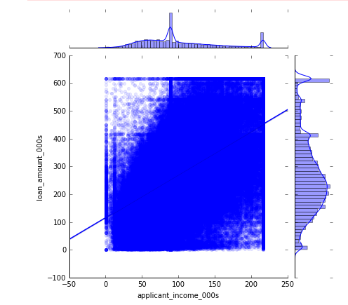
EDA
Correlation Between Loan Amount and Applicant Income
Pearson correlation coefficient was calculated using np.corrcoef() and a hypothesis test was calculated to test the correlation coefficient.
A t-statistic, confidence interval and P-value was calculated and determined that there was a low chance of getting the observed correlation coefficient.
However scatter plot does show some positive correlation between loan amount and applicant income.

Slide 9
Prediction Model
Four models are used for loan approval prediction
Logistic Regression from SKLearn
GLM and Logistic Regression from StatsModels
Random Forest
XGBOOST
Data will be trained and tested on all the above four algorithms. Model will be evaluated by calculating
Accuracy score
Precision and Recall
Confusion matrix
ROC Area

Slide 10
Prediction Model - Logistic Regression using SKLearn
Split data for training and testing with all the features.
Recursive Feature elimination(RFE) method is used for feature selection.
After find most important features from RFE, again split data for train and test based on features selected.
Second split data for tuning hyperparameter C using GridSearchCV.
Confusion Matrix and Precision and Recall is computed for determining accuracy.
Above steps are repeated for all 25 features by eliminating one at a time

Slide 11
Prediction Model - Logistic Regression using SKLearn
Precision and Recall
class | precision | recall | f1-score | support
0 | 0.77 | 0.77 | 0.77 | 18723
1 | 0.93 | 0.93 | 0.93 | 62115
Confusion Matrix
 | Predicted 0 | Predicted 1
Actual 0 | 14377 | 4346
Actual 1 | 4203 | 57912
Area Under curve score : 0.894245280685

Slide 12
Prediction Model - Logistic Regression using SKLearn
Feature Importance with Coefficients
purchaser_type_name : 2.64912139139
application_date_indicator : 0.678134593229
agency_name : 0.440960808163
loan_purpose_name : 0.394873550464
lien_status_name : 0.199213009858
applicant_sex_name : 0.182303123995
preapproval_name : 0.165103198597
co_applicant_ethnicity_name : 0.0562936316467
msamd_name : 0.0228445107127
applicant_income_000s : 0.00546084063481
loan_amount_000s : 0.0016369371761
number_of_owner_occupied_units : 0.000363495340591
hoepa_status_name : 0.000253244350495
census_tract_number : 1.59324814892e-06
hud_median_family_income : -1.45322566506e-05
population : -3.3019326535e-05
number_of_1_to_4_family_units : -0.000265665383835
owner_occupancy_name : -0.00221655093575
tract_to_msamd_income : -0.00319185224085
minority_population : -0.00540672824681
property_type_name : -0.0253570700574
applicant_ethnicity_name : -0.0327905508411
county_name : -0.0406843239824
co_applicant_sex_name : -0.0877752616605
loan_type_name : -0.367246414504

Slide 13
Prediction Model – Logit and GLM using stats model
Both logit and GLM yield same result.
Precision and recall
Confusion matrix
class | precision | recall | f1-score | support
0 | 0.74 | 0.83 | 0.79 | 18723
1 | 0.95 | 0.91 | 0.93 | 62115
 | Predicted 0 | Predicted 1
Actual 0 | 15624 | 3099
Actual 1 | 5350 | 56765

Slide 14
Prediction Model – Random Forest
In this model hyperparameters are tuned using RandomizedSearchCV. Hyperparameters found in RandomizedSearchCV are used to for learning RandomForestClassifier. This model is tested on test data and evaluated using accuracy, precision and recall, and confusion matrix.
Hyperparameters tuning
n_estimators - the number of trees in the forest. Usually higher number of trees the better to learn the data. n_estimators = [4, 8, 16, 32, 64, 100, 200]
max_features - number of features to consider when looking for the best split. max_features = [2, 4, 5, 10, 15, 20, 25]
max_depth - depth of the tree, the more splits it has and it captures more information about the data. But as the tree gets very deep, it might lead to overfitting. max_depth - [4, 8, 10, 12, 16, 32, 64]

Slide 15
Prediction Model – Random Forest
Hyperparameters tuning continued ….
min_samples_split - number of samples required to split an internal node. smaller samples might lead to overfitting. min_samples_split = [2, 4, 6, 8, 10, 12, 16, 32, 64]
min_samples_leaf - The minimum number of samples required to be at a leaf node. smaller samples might lead to overfitting. min_samples_leaf = [2, 4, 6, 8, 10, 12, 16, 32, 64]
criterion - ['gini','entropy']
bootstrap - [True, False]

Slide 16
Prediction Model – Random Forest
Precision and recall
class | precision | recall | f1-score | support
0 | 0.80 | 0.84 | 0.82 | 18723
1 | 0.95 | 0.94 | 0.94 | 62115
Confusion Matrix
 | Predicted 0 | Predicted 1
Actual 0 | 15640 | 3083
Actual 1 | 3979 | 58136

Slide 17
Prediction Model – Random Forest
Feature ranking:
feature purchaser_type_name (0.684821)
feature agency_name (0.061374)
feature loan_purpose_name (0.040386)
feature applicant_income_000s (0.037195)
feature loan_amount_000s (0.028927)
feature application_date_indicator (0.028002)
feature lien_status_name (0.017696)
feature applicant_sex_name (0.015376)
feature loan_type_name (0.014553)
feature co_applicant_ethnicity_name (0.008757)
feature tract_to_msamd_income (0.007277)
feature census_tract_number (0.006767)
feature minority_population (0.006365)
feature preapproval_name (0.005608)
feature co_applicant_sex_name (0.005432)
feature population (0.004687)
feature number_of_owner_occupied_units (0.004635)
feature number_of_1_to_4_family_units (0.004509)
feature applicant_ethnicity_name (0.004251)
feature county_name (0.004085)
feature hud_median_family_income (0.003347)
feature msamd_name (0.002703)
feature property_type_name (0.001703)
feature owner_occupancy_name (0.001544)
feature hoepa_status_name (0.000000)

Slide 18
Prediction Model – XGBOOST
In this model hyperparameters are tuned using RandomizedSearchCV. Hyperparameters found in RandomizedSearchCV are used to for learning XGBClassifier. This model is tested on test data and evaluate using precision and recall, and confusion matrix.
Hyperparameters Tuning
n_estimators - number of trees to grow. Larger the tree size better the model, but more numbers of trees can be computationally expensive and affects the performance of the model n_estimators = [4, 8, 16, 32, 64, 100, 200]
max_depth - depth of the tree, the more splits it has and it captures more information about the data. But as the tree gets very deep, it might lead to overfitting max_depth = [4, 8, 10, 12, 16, 32, 64]

Slide 19
Hyperparameters Tuning continued….
min_child_weight - Minimum sum of instance weight needed in a child. min_child_weight = [2, 4, 6, 8, 10, 12, 16, 32, 64]
gamma - [0.1, 0.2, 0.3, 0.4, 0.5]
colsample_bytree - Subsample ratio of columns when constructing each tree. colsample_bytree = [0.2, 0.4, 0.6, 0.8]
colsample_bylevel - Subsample ratio of columns for each split, in each level colsample_bylevel = [0.2, 0.4, 0.6, 0.8]

Slide 20
Prediction Model – XGBOOST
Precision and recall
class | precision | recall | f1-score | support
0 | 0.81 | 0.82 | 0.81 | 18723
1 | 0.95 | 0.94 | 0.94 | 62115
Confusion Matrix
 | Predicted 0 | Predicted 1
Actual 0 | 15403 | 3320
Actual 1 | 3711 | 58404

Slide 21
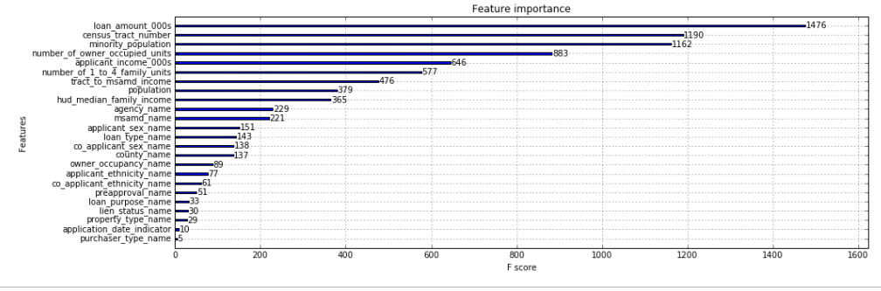
Prediction Model – XGBOOST

Slide 22
Conclusion
Among all the four models, XGBOOST and Random Forest do better than other models. XGBOOST and Random Forest both have almost same precision and recall. Random Forest is 1% better(F1-Score) at predicting loan rejection rate than XGBOOST.

